Slide 1
Lecture-1 MICROCONTROLLER

Slide 2
WHAT ARE MICROCONTROLLERS ?
A micro-controller (also MCU or µC) is a functional computer system-on-a-
chip. It contains a processor core, memory and programmable input/output
peripherals.
Micro suggests that the device is small and controller tells you that the device
might be used to control objects, processes or events.
Another term to describe a microcontroller is embedded controller because
the microcontroller and its support circuits are often built into or embedded
in the devices they control.

Slide 3

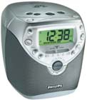

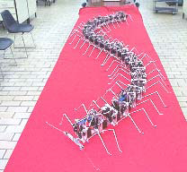
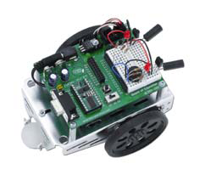
WHERE WE USE THEM…???

Slide 4
Microprocessor vs. Microcontroller
Microprocessor
CPU is stand-alone, RAM, ROM, I/O, timer are separate
designer can decide on the amount of ROM, RAM and I/O ports.
expensive
general-purpose
Microcontroller
CPU, RAM, ROM, I/O and timer are all on a single chip
fix amount of on-chip ROM, RAM, I/O ports
for applications in which cost, power and space are critical
single-purpose
Notes:
versatility 多用途的: any number of applications for PC

Slide 5
Embedded System
Embedded system means the processor is embedded into that application.
An embedded product uses a microprocessor or microcontroller to do one task only.
In an embedded system, there is only one application software that is typically burned into ROM.
Example：printer, keyboard, video game player
Notes:
processor 整合到整個系統中, 你只看到此系統的外觀, 應用, 感覺不到有 processor 在其中.
Embedded system 通常只有一項應用, 而 PC 有許多 applications (game, accounting, fax, mail...)
A printer is an example of embedded system since the processor inside it performs one task only.

Slide 6
Three criteria in Choosing a Microcontroller
meeting the computing needs of the task efficiently and cost effectively
speed, the amount of ROM and RAM, the number of I/O ports and timers, size, packaging, power consumption
easy to upgrade
cost per unit
availability of software development tools
assemblers, debuggers, C compilers, emulator, simulator, technical support
wide availability and reliable sources of the microcontrollers.

Slide 7
TYPES OF MICROCONTROLLER
Types based on architecture
1. Havard architecture
2. Von Neuman architecture

Slide 8
TYPES OF MICROCONTROLLER
Types based on vendor or provider
AVR
PIC
Motorolla etc
Hitachi,

Slide 9
Working with microcontroller
Working with microcontroller can be divided into three steps:-
programming the microcontroller
Connect to the external network
Burning it inside the IC.
1
2
3

Slide 10
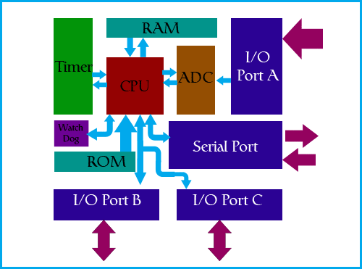
Basic block diagram of a microcontroller

Slide 11
CPU :
CPU does all the arithmetic and logic operations.
It controls the flow of execution of instructions.

Slide 12
RAM ( Random Access Memory) :
RAM holds the set of instructions (program), i.e. being executed by the CPU.
It holds important data required by the program.
It holds some important data structures like ‘stack’.
It is volatile in nature.

Slide 13
ROM ( Read Only Memory) :
ROM holds very important data and initialization about the microcontroller.
It holds the monitor program.

Slide 14
Flash Memory :
Flash memory is basically EEPROM.
It holds the program written by the user.
The program can be erased or written here many times. ( Specified by the manufacturer)

Slide 15
I/0 Ports :
Every microcontroller has I/O ports.
Each port is made up of n-pins ( mostly 8 pins).
Each pin can be configured as either input pin or output pin.
If a pin is input pin, it accepts data from the device it is connected to.
If a pin is output pin, it sends the data to the device it is connected to.
Thus these pins form the input/output medium for the microcontrollers.

Slide 16
ADC :
Most of the real world signals are analog in nature.
But a microcontroller is a digital device, thus it cannot process analog signals.
Thus all microcontrollers have built in A-D converters.
ADC digitizes an analog signal and gives it to the microcontroller for further processing.

Slide 17
TIMERS :
In many applications, time keeping is a must. Eg. If you heating a meal in an oven.
Thus microcontrollers have timers to measure time.

Slide 18
WATCHDOG :
A watchdog is a device used to protect a system from specific software or hardware failures that may cause the system to stop responding. The application is first registered with the watchdog device. Once the watchdog is running on your system the application must periodically send information to the watchdog device. If the device doesn't receive this signal within the set period of time it would execute the proper keystrokes to reboot the machine or restart the application.

Slide 19
SOME COMMON MICROCONTROLLERS
Intel - 8051
Atmel – Atmega 16
PIC
ARM

Slide 20
Question: How a microcontroller works ???
Answer: Microcontroller consists of a Microprocessor (CPU i.e. Central processing Unit) which is interfaced to RAM (Random Access Memory) and Flash Memory (EEPROM). You feed your program in the Flash Memory on the microcontroller. Now when you turn on the microcontroller, CPU accesses the instructions from RAM which access your code from Flash. It sets the configuration of the pins and then start performing according to your program.

Slide 21
Question: How to make the code ?
Answer: You basically write the program on your computer in any of the high level languages like C, C++, JAVA etc. Then you compile the code to generate the machine file.
All the machines understand only one language, 0 & 1 that is on and off. Now this 0 & 1 both corresponds to 2 different voltage levels for example 0 volt for 0 logic and +5 volt for 1 logic. Actually the code has to be written in this 0, 1 language and then saved in the memory of the microcontroller. But this will be very difficult task. So we write the code in the language we understand (eg. C) and then compile and make the machine file “.hex”. After we make this machine file we feed this to the memory of the microcontroller.

Slide 22
Question: How to feed the code in the flash of Microcontroller ?
Answer: Assuming you have the machine file (.hex) ready and now you want to feed that to the flash of the microcontroller. Basically you want to make communication between your computer and microcontroller. Now computer has many communication ports such as Serial Port, Parallel Port and USB (Universal Serial Bus).
Let’s take Serial Port, it has its own definition that is voltage level to define 0 & 1. Serial Port's protocol is called as UART (Universal Asynchronous Receiver & Transmitter). Its voltage levels are : +12 volt for 0 logic and -12 volt for 1 logic.
Now the voltage levels of our microcontroller are based on CMOS (Complementary Metal Oxide Semiconductor) technology which has 0 volt for 0 logic and +5 volt for 1 logic. Two different machines with 2 different ways to define 0 & 1 and we want to exchange information between them. Consider microcontroller as a French and Computer's Serial Port as an Indian person. If they want to exchange information they basically need a mediator who knows both the language. He will listen one person and then translate to other person. Similarly we need a circuit which converts CMOS (microcontroller) to UART (serial port) and vice versa. This circuit is called as programmer. Using this circuit we can connect computer to the microcontroller and feed the machine file to the flash.

Slide 23
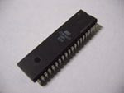

ATMEGA 16 MICROCONTROLLER
Manufacturer : ATMEL CORPORATION, USA.
http://www.atmel.com/

Slide 24
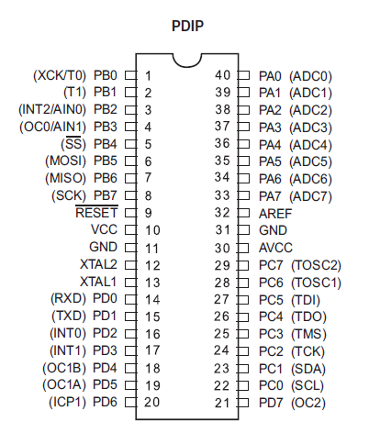
PIN CONFIGURATION :

Slide 25
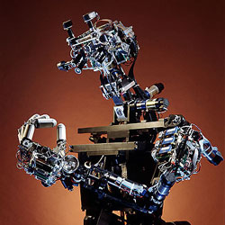
Microcontroller – part and parcel of AI

Slide 26

Part and parcel of robotic projects

Slide 27
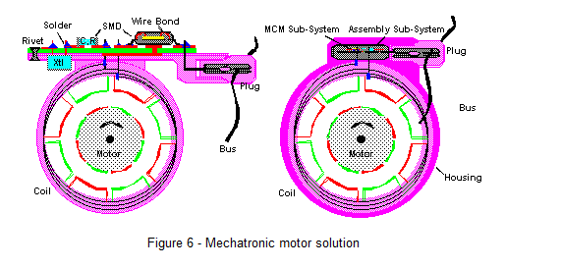
Uses in automobile engine control system
Notes:
http://www.mcjournal.com/articles/arc105/arc105.htm

Slide 28
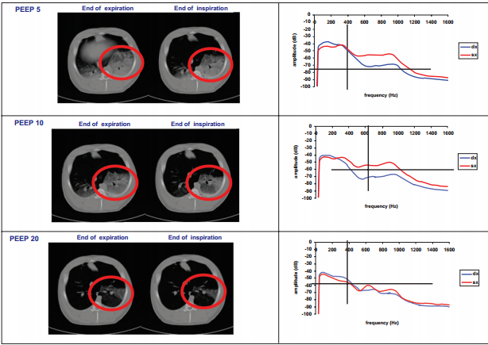
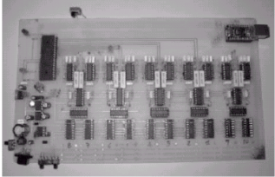
Microcontrollers in medical devices

Slide 29
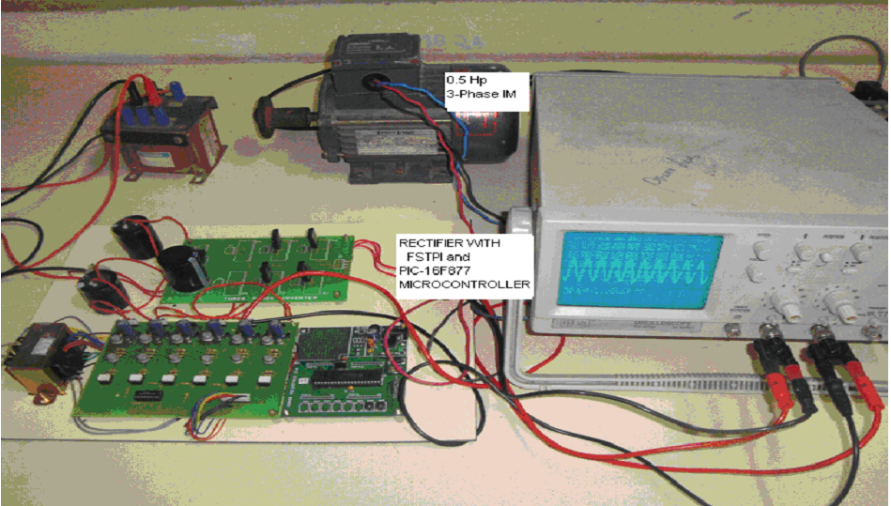
Microcontrollers in power system

Slide 30
THE END

